Slide 1
Key Security Attacks in Connected Car
  Arbitrarily modify firmware
  Maliciously update remote firmware
  Illegitimately accessing and modifying data in vehicle – temperature, fuel levels, diagnostic trouble codes etc.
  Inject arbitrary CAN packet
  Lock/Unlock doors
  Turn On/Off vehicle
  Affect vehicle GPS tracking, speed, heading and altitude

Slide 2
Common Architecture Issues
The Primary Processor
Simple processor
Convert External Network Protocol to CAN & vice versa
Do not include any security e.g. authentication, command validation
External Network Interface
Due to no filtering at device, security is completely dependent on external network interface
External network interface security strength varies
WPA2 with no strong password
- Easy to guess BT PIN
- Widely shared BT PIN
Insecure Firmware upgrades

Slide 3
Best Practices towards Secure Automotive System
Hardware Security
  Secure Boot and software attestation
  Trusted Platform Module
  Tamper Protection
  Trusted Execution Environment or Cryptographic Computing Acceleration
  Active Memory Protection
Software Security
  Secure Boot
  Partitioned OS
  Authentication
  Secure Software Download
  Secure Interfaces with external world (OTA, OBD, Bluetooth)
  In-vehicle secure network architecture providing physical segregation and isolation of safety related ECUs using secure gateways and communication buses
Cloud Security
  Secure authenticated channel to cloud
  Remote monitoring of Vehicle
  Threat intelligence exchange
  OTA Upgrades
  Credential Management
Network Security
  Message and Device Authentication
  Access Control
  Tamper Protection
  Trusted Execution Environment or Cryptographic Computing Acceleration
  Active Memory Protection
End to End Security

Slide 4
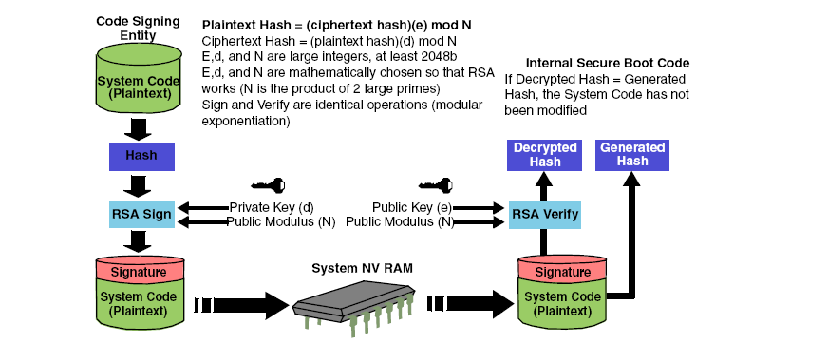
Code Signing and Validation

Slide 5
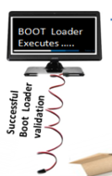







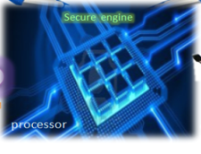





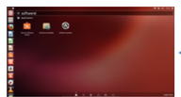

Secure Boot Flow
Power ON
Proprietary & Confidential. ©Aricent Group 2011

Slide 6
Demo Setup
ISBC validates and boots the External Secure Boot Code (ESBC) from NAND Flash
ESBC validates and boots SW images from NAND Flash
2
P1010
Internal ROM
NAND Flash
CF Header
3
ISBC
ESBC Header
ESBC (U-boot) Image
SW Image CSF Headers(Linux Kernel + Device tree + RootFS)
Secure Fuse Processor
SW Image (Linux Kernel + Device tree + RootFS) – BANK 1
SRKH
1
Validates SoC state and allows the Internal Secure Boot Code (ISBC) to execute from Internal ROM
Proprietary & Confidential. ©Aricent Group 2011

Slide 7
Thank you

